Slide 1
3in1 Next Gen Web Application
Defense Logistics Agency
Presented by 3in1 PMO
Notes:
D Guidance 26-Jun: Would like to see a refresh of this title slide. Should be able to see representation of all services and civilians (i.e. humanitarian effort). Director would like for us to bring him a few recommendations of possible design refreshes.

Slide 2
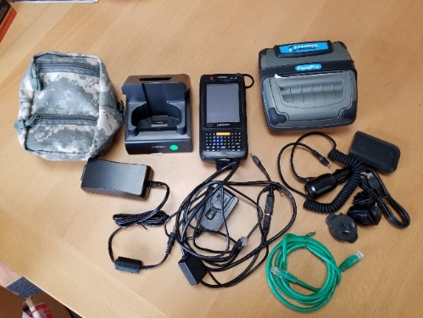
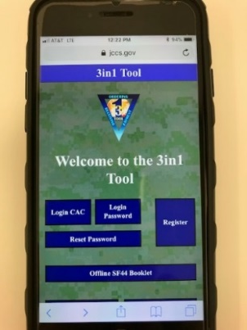
About 3in1
The 3in1 Tool automates three key processes; Field Ordering, Receiving, and Payment, in one solution normally accomplished with the Standard Form 44. The 3in1 Tool will record and transmit cash and carry type purchases to the 3in1 database for reconciliation and review
(Before) 3in1 Toolkit:
Consisted of 2 main components
  Device Kit, Desktop Application
Software
  Application built in Droid (v2.1)
Connectivity available multiple ways
  GSM, WiFi, Ethernet
(Now) 3in1 Next Gen:
Simplified Web Application
Device Agnostic
  Laptop, Tablet, Mobile/Phone
Platform Agnostic
  iOS, Android, Windows
Eliminated need for CON by utilizing existing unit GFE

Slide 3

Benefits of 3in1 NG
Code built in HTML 5
  Platform Agnostic
    iOS, Android, Windows, etc.
  Device Agnostic
    Laptop, Tablet, Mobile/Phone, etc.
Visibility in Purchasing Power
  All orders placed by users are retained at DISA Ogden
  Ability to run Purchase Log reports anywhere
    Provides better purchasing power and answer data calls
Patches/Updates easy to administer
  Updates are instantaneous (no more OTA updates)
  All users on same build of software in the field
Logistical shipping and Accountability of hardware omitted
Offline capability for users not wanting to emit a signal
Reduced Pre set-up needed prior to utilization
More self-intuitive/simplified for users

Slide 4
Menu
Accessing 3in1/Menu Options
Registration
SF44 Orders
Adding Certificates to Mobile Device
KO Dashboard
IOS
Android

Slide 5
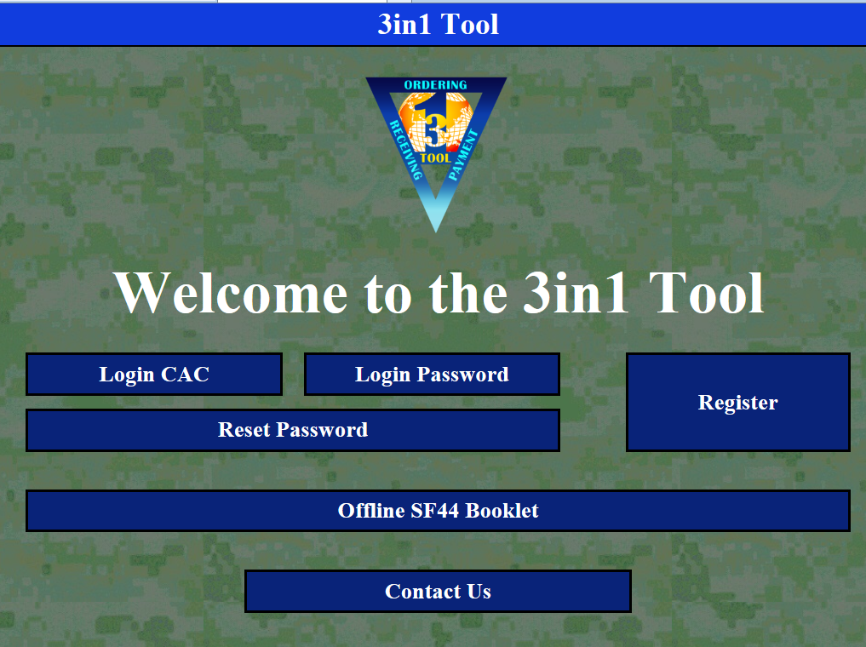
Accessing 3in1
Access 3in1 at https://www.jccs.gov/3in1ng/
Training Environment Available https://www.jcxs.etcx.dla.mil/3in1ng/

Slide 6
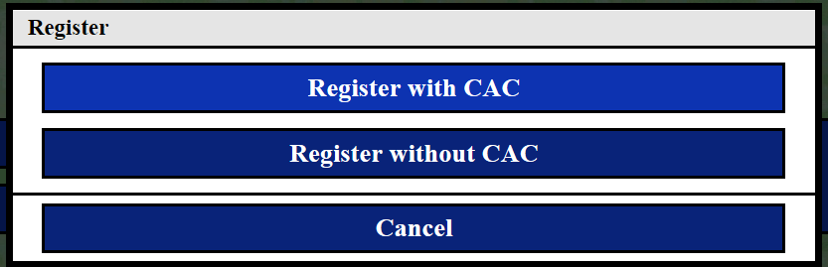
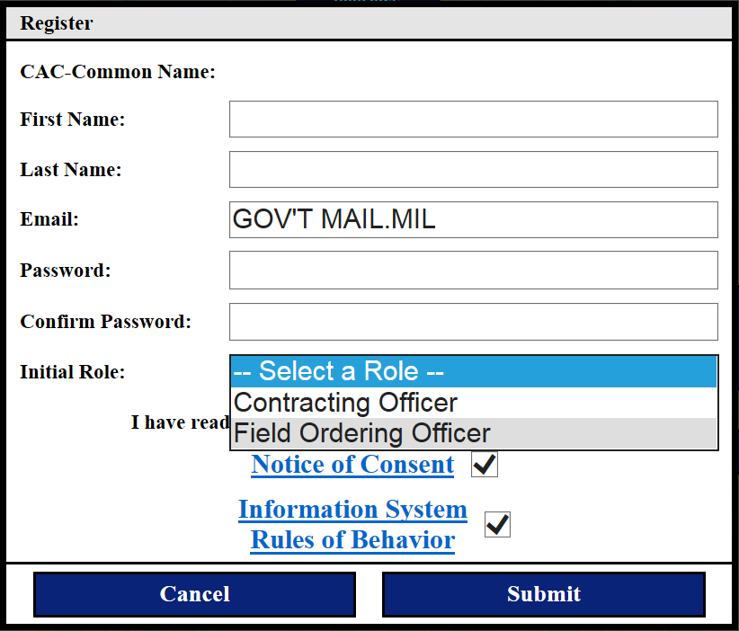
Registration
Users can register with CAC or without a CAC using Username/Password
After a user registers a new account, an email will be sent to the user once the account is approved.
Fill in all of the registration fields; all are required to register an account

Slide 7
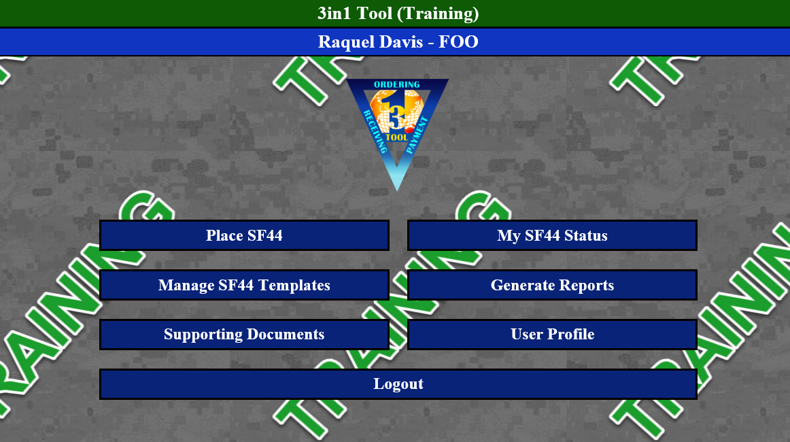
FOO Dashboard
Place a new SF44 order
Check the status of submitted orders
View, Create, and Edit SF44 Templates for east entry
View/Generate Reports
Upload/View Documents
View user level and DODAAC associations
FOOs are limited to being able to place new SF44 orders and check the status of their submitted SF44s

Slide 8
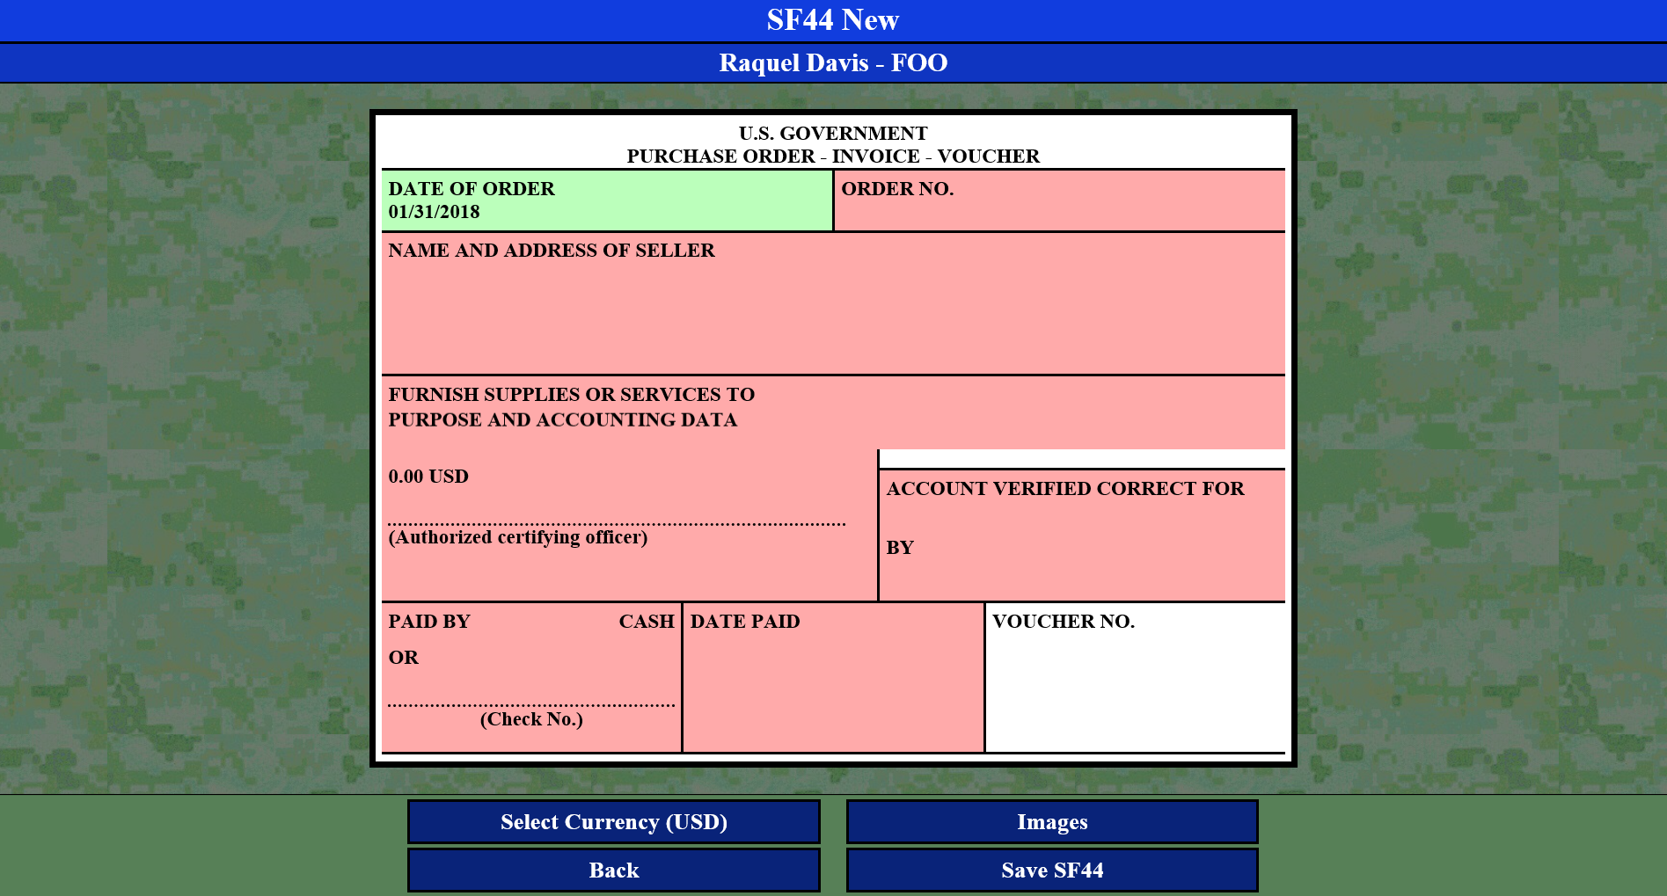
Place SF44 from Blank Form
The 3in1 electronic form replicates the paper SF44
Able to change currency. The exchange will automatically calculate
Users are able to upload images to the order (receipts, pictures of supplies purchased, etc)

Slide 9
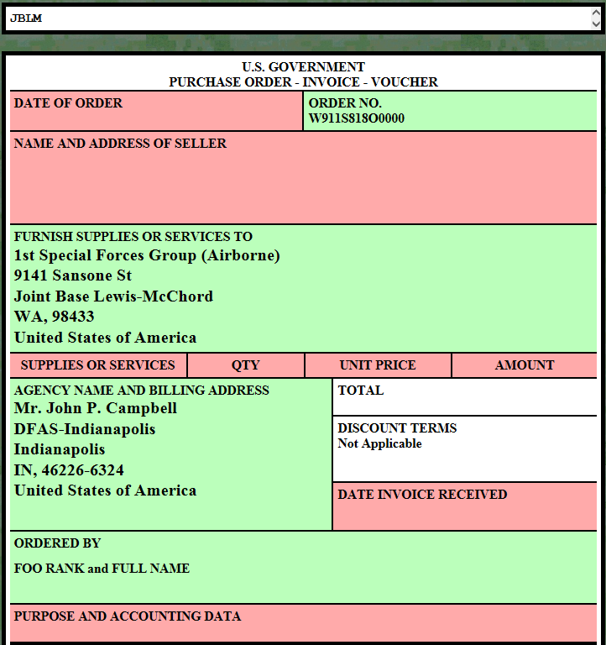
Place SF44 From Blank Form
As the sections are filled, the sections will turn from red to green

Slide 10
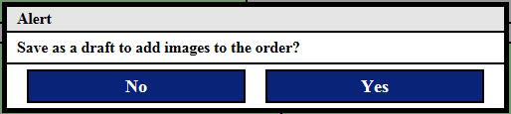
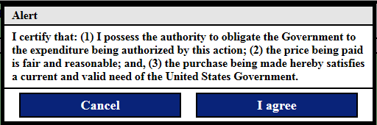
Adding Images & Saving SF44s
By selecting Images at the bottom of the SF44 the website will allow for users to attach a picture of the receipts. FOOs will be prompted to save as a draft before adding a photo.
By selecting Save SF44 the FOO will be promoted with the following statement. Once they have agreed it will then transmit to the appropriate KO.

Slide 11
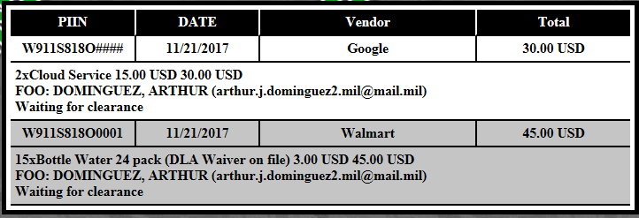
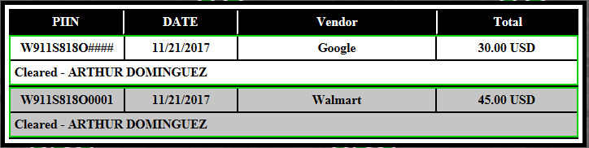
Checking SF44 Status
My SF44s Status will allow the FOOs to check the status of their submitted forms. *In theory they wouldn’t need to submit once every 30 days but instead they can submit as often as they are able to connect to the internet. (This doesn’t prevent them for the mandatory monthly reconciliation but allows for the system to be an ongoing process.)

Slide 12
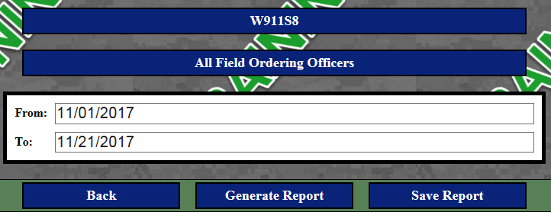
Generate Reports
KO may make Selection of Data being Pulled
Able to Select Data Range for Customizable Reports
Display of Generated Report

Slide 13
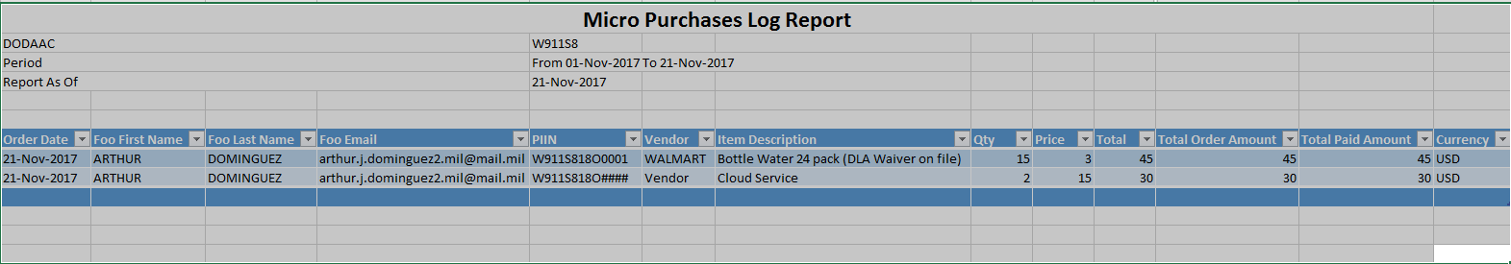
Generate Reports
By selecting Save Report the system will prompt user to open/save an Excel document that can be customized by DODAAC.

Slide 14
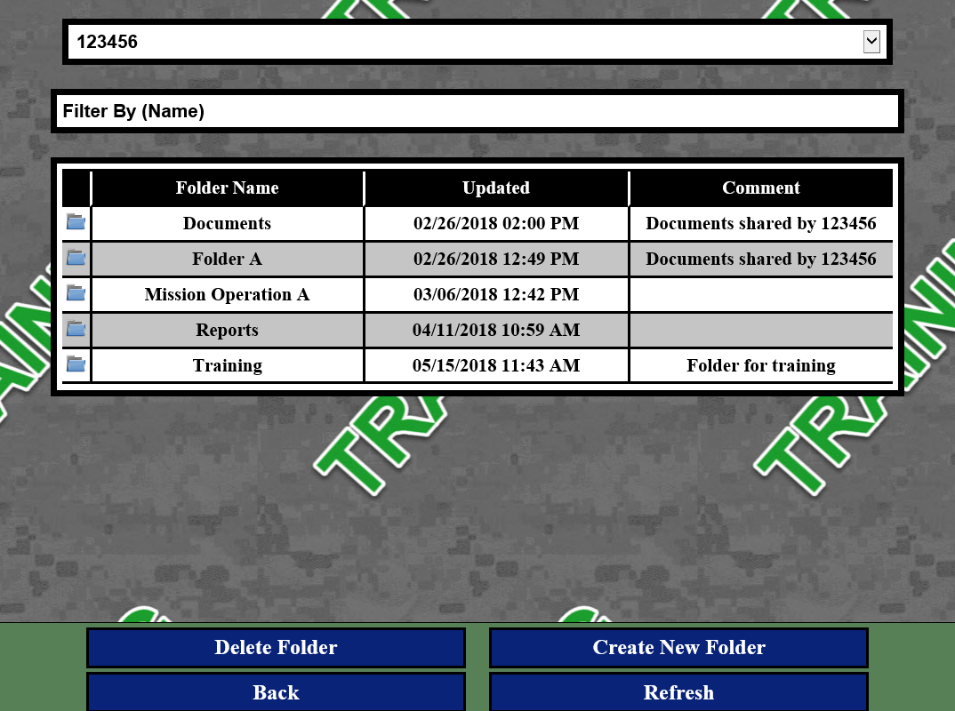
Supporting Documents
3in1 NG serves as a centralized data repository for documents such as Mission Essential Letters, Appointment Letters, and other critical purchase order documents
Select the DODAAC
The option to filter/search documents by name
Folders Display
Delete and Create Folders

Slide 15
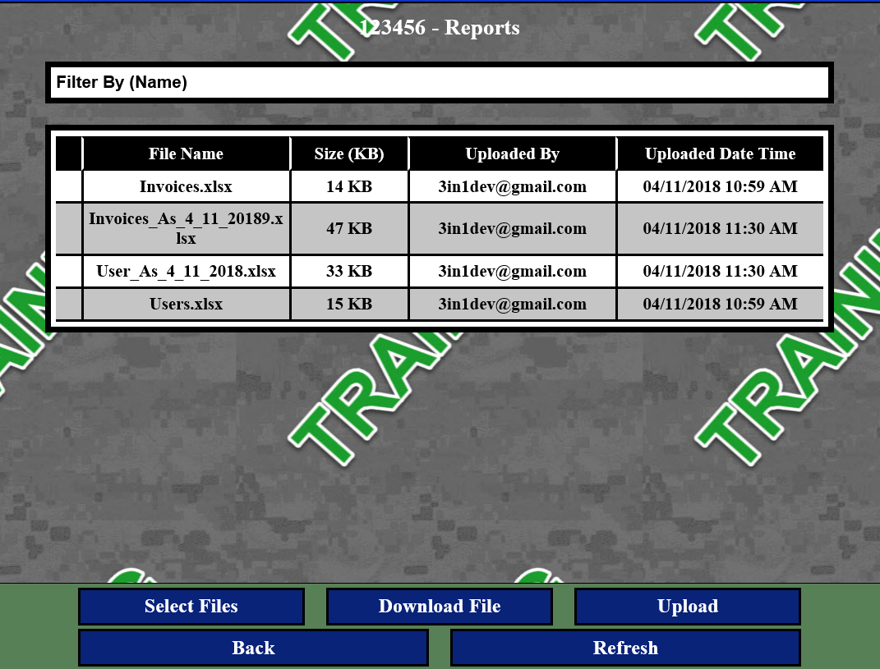
Supporting Documents
Filter/Search documents by name
Documents uploaded to the selected folder
Select Files to delete documents
Upload new documents to the folder

Slide 16
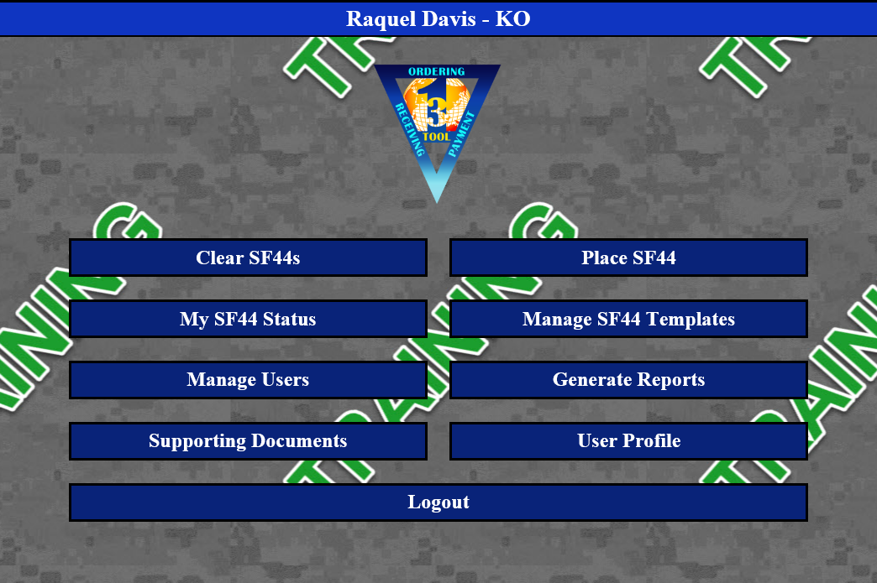
KO Dashboard
Clear Pending Orders
Place a New SF44 order
View, Create, and Edit SF44 Templates for east entry
Check the Status of Orders
Manage Users’ DODAAC associations
Generate Purchase Log Reports of Uploaded Orders
View/Upload Documents
View User Level and DODAAC Associations

Slide 17
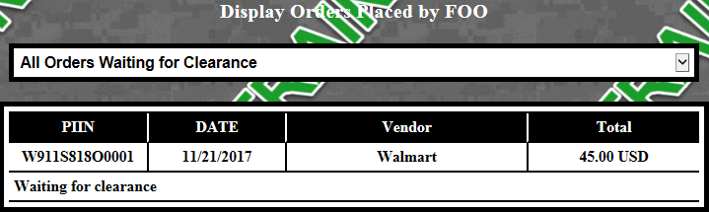
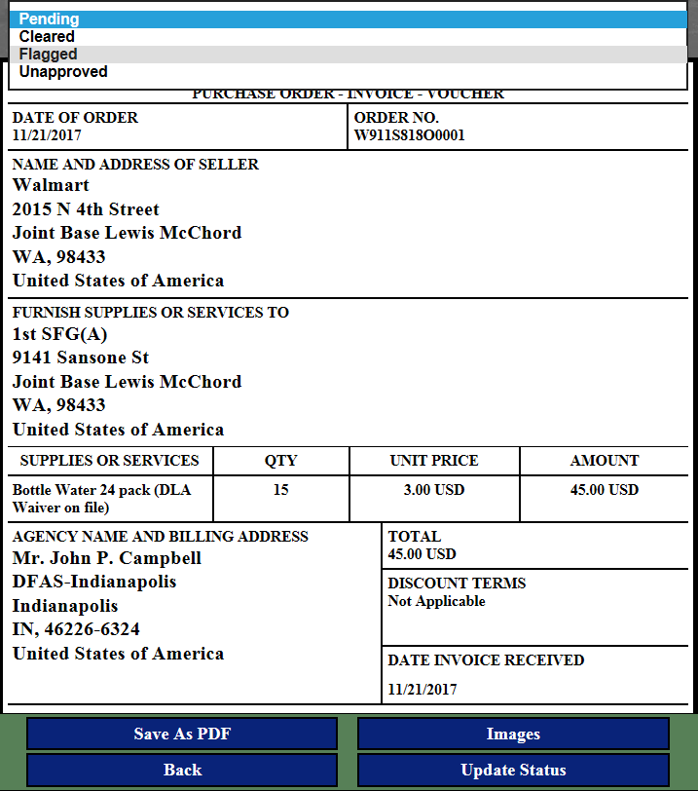
Clear SF44s
Default status is Pending.
Review SF44 and Images.
If errors or missing images flag and provide comments.
If unapproved (UAC) provide comments.
Flagging or Unapproved will return the a SF44 to the FOO to correct and resubmit.
If cleared update status and the order will be processed.

Slide 18
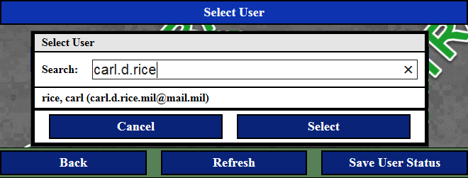
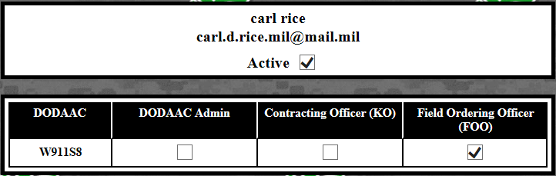
Manage Users
KOs can search for any user who has a 3in1 account. Partial searches will retrieve users
KOs can mark users active/inactive to their DODAAC as an Admin, KO. Or FOO

Slide 19
3in1 on a Mobile Device
3in1 is designed to support the warfighter in Theater. The application is accessible on Airplane Mode when no service is available, or when transmitting a signal is not an option.
Initial Log-in must be done while connected to the internet in order to cache the page
If using a “personal device” rather than a GFE, DoD Certificates must be downloaded and installed to the device. Follow instructions from the 3in1 site to install certs on the device
After initial log-in while connected to the internet, the site is available to use with or without connectivity

Slide 20
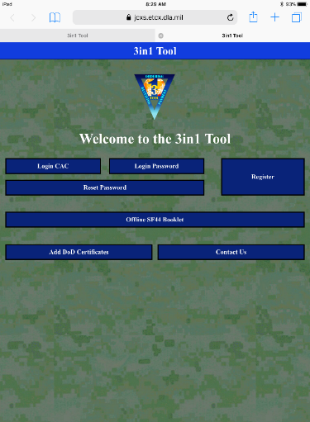
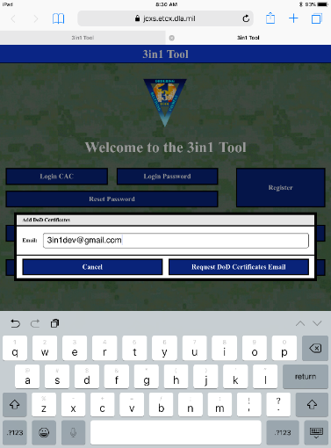
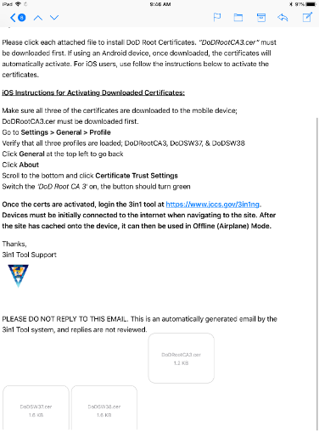
Adding Certificates to Device
Step 1: Log onto 3in1 website and select “Add DoD Certificates” to have the certs emailed to your device
Step 2: Enter your email, Select “Request DoD Certificates Email
Step 3: Use the email sent to the address and click each attachment (3) to install them to the device

Slide 21
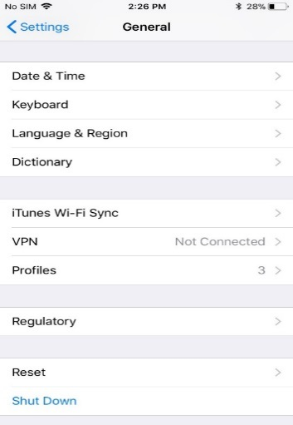
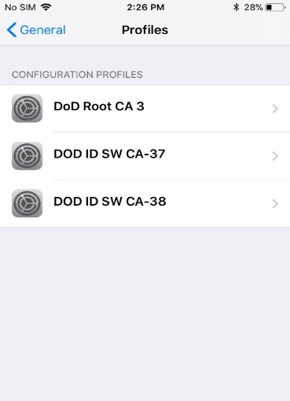
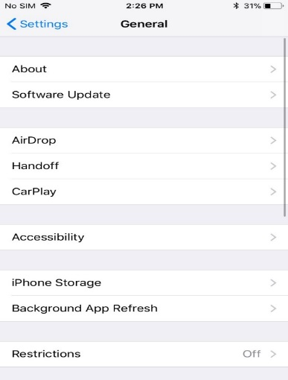
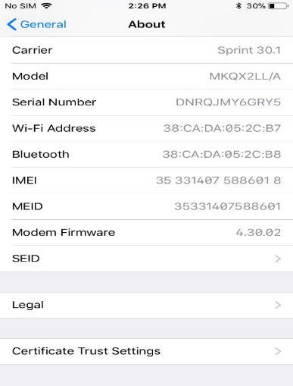
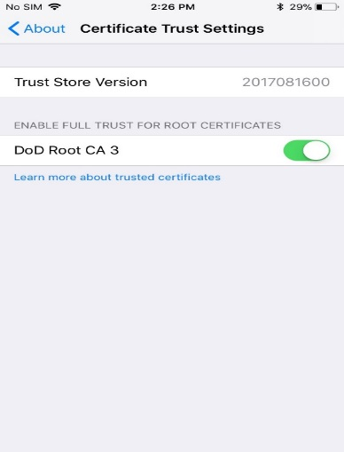
Adding Certificates to iOS Device
Step 1: Once installed, go to the “Settings” app, under General, Click “Profiles”. Ensure all 3 certs are displayed, go back to the Settings page by clicking “General” at the top left
Step 2: Click “About”, then “Certificate Trust Settings” and enable to DoD Root CA 3 cert. Select “Continue” on the Root Certificate pop-up

Slide 22
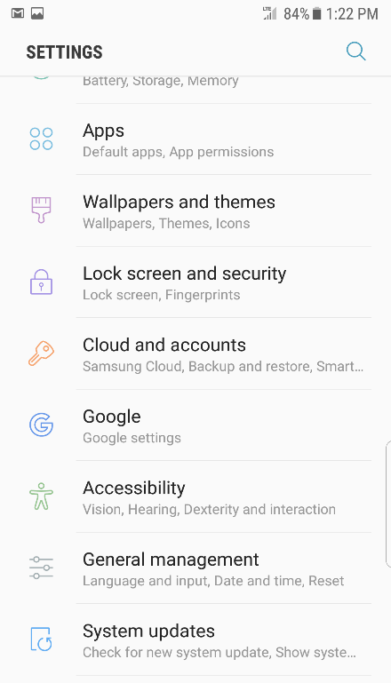
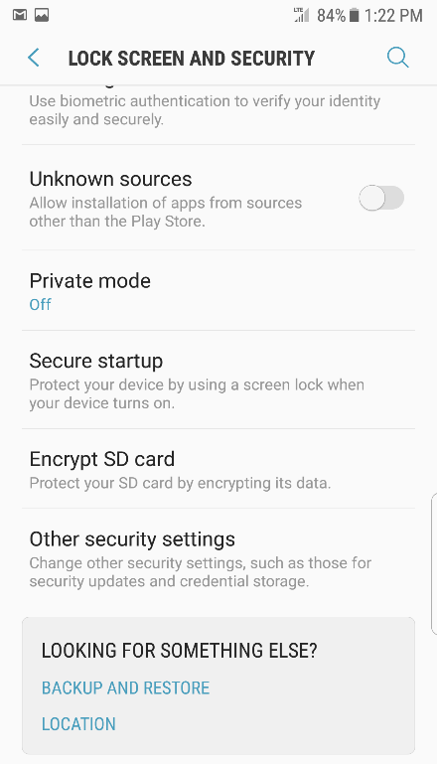
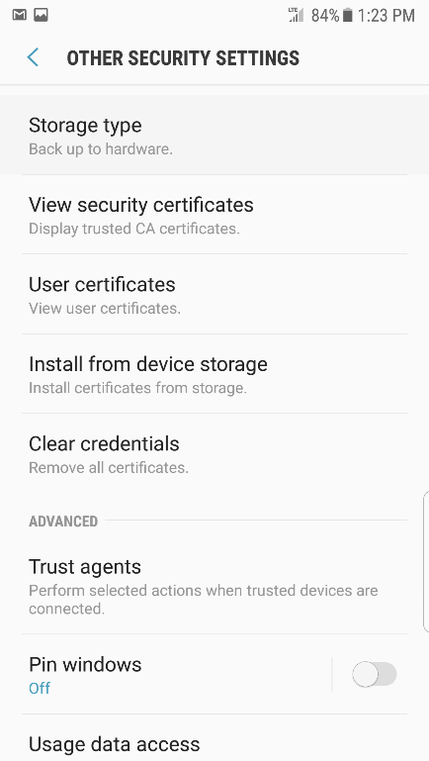
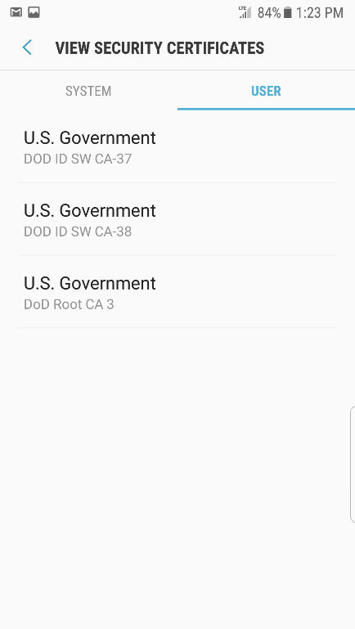
Adding Certificates to Android Device
Step 1: From the Settings menu, click on “Lock Screen and Security”
Step 2: Click “Other Security and Settings”
Step 3: Click “View Security Certificates”
Step 4: Click on the “User” tab to confirm that the 3 DoD Certificates (DoD Root CA3, DoD ID SW CA-38, and DoD ID SW CA-37) appear

Slide 23

Questions?

